Slide 1
Hortonworks Genomics Analytics Platform Launching a new era
Greg Keys Eran Orgad Hari Rongali

Slide 2
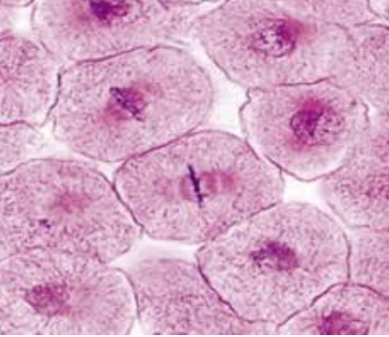
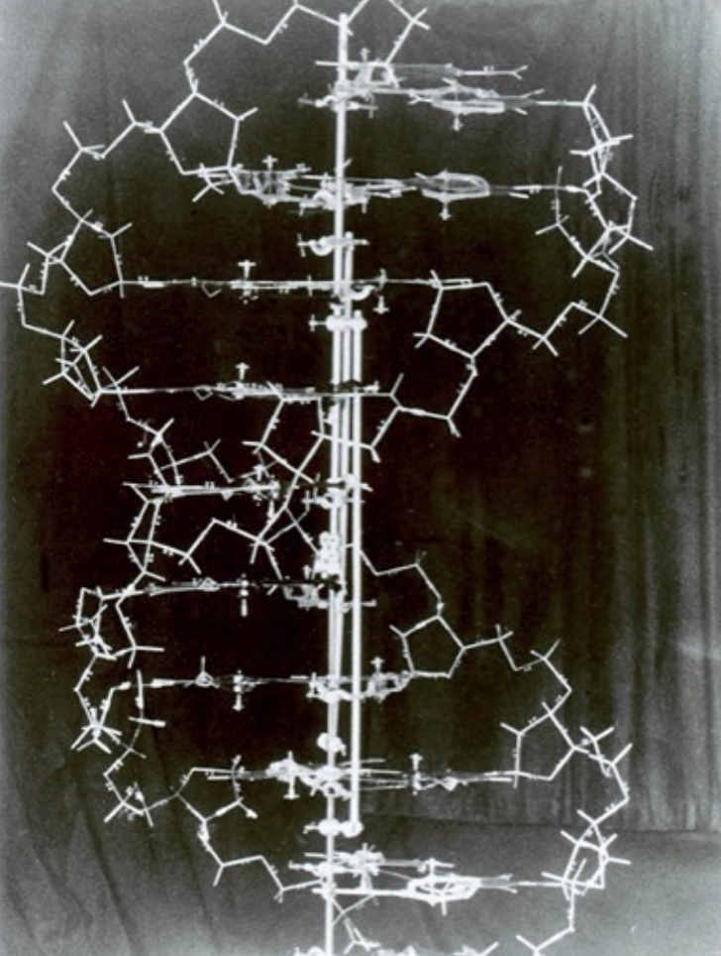
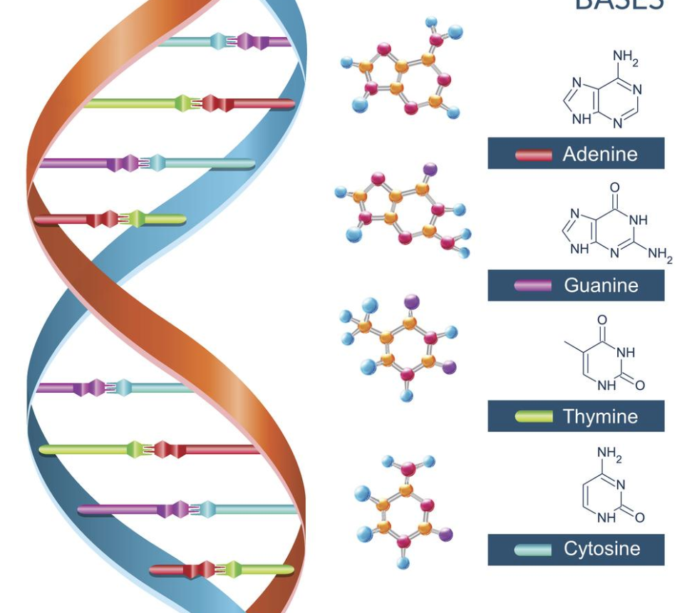

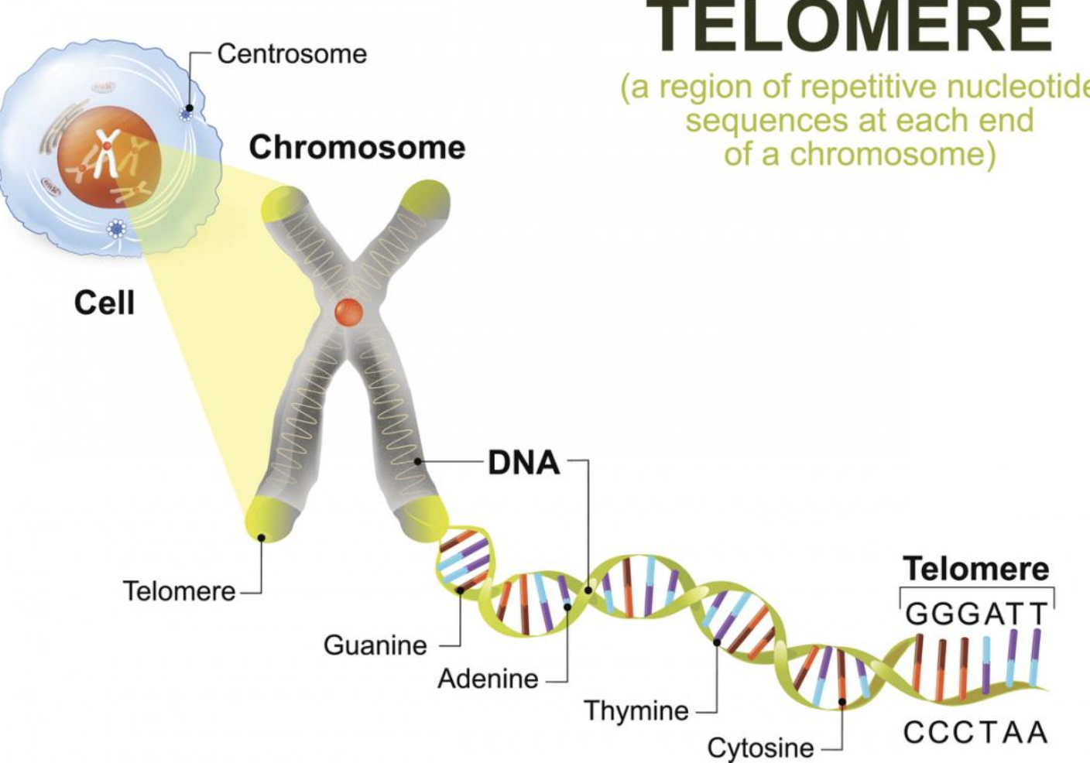
Genomic Data: A Primer
1953
?
2001
?

Slide 3
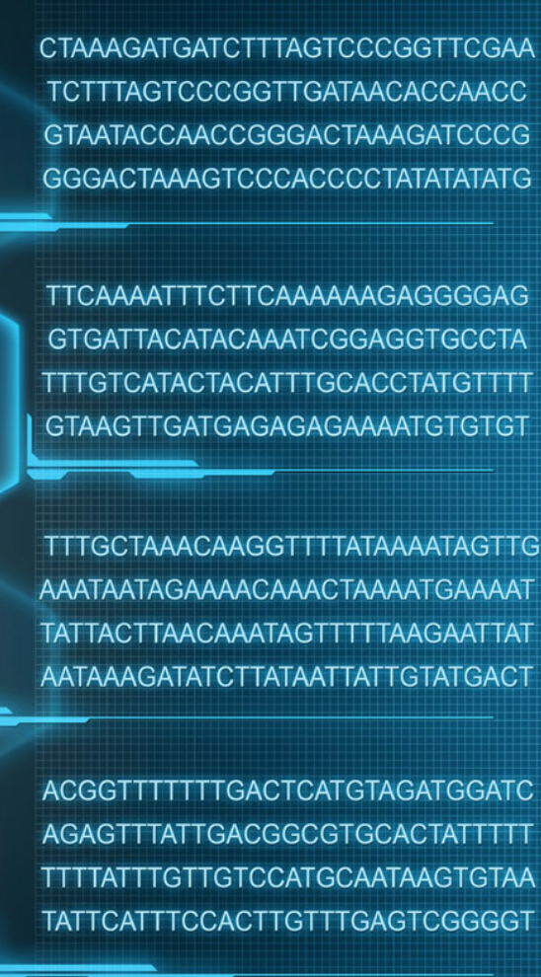
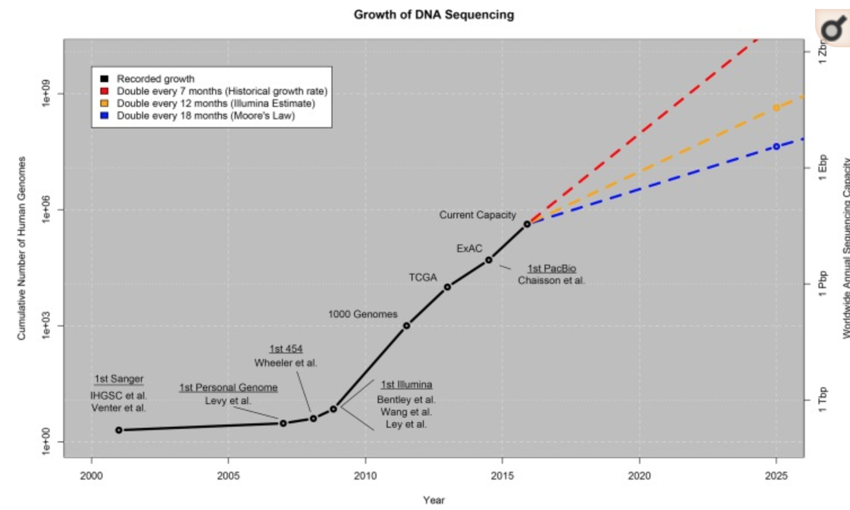
Genomic Data: Astronomical Explosion
A single human gene sequence: [G|C|T|A] x 3 billion
Total human sequences: Astronomical Explosion

Slide 4
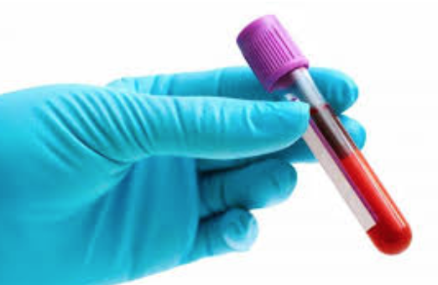
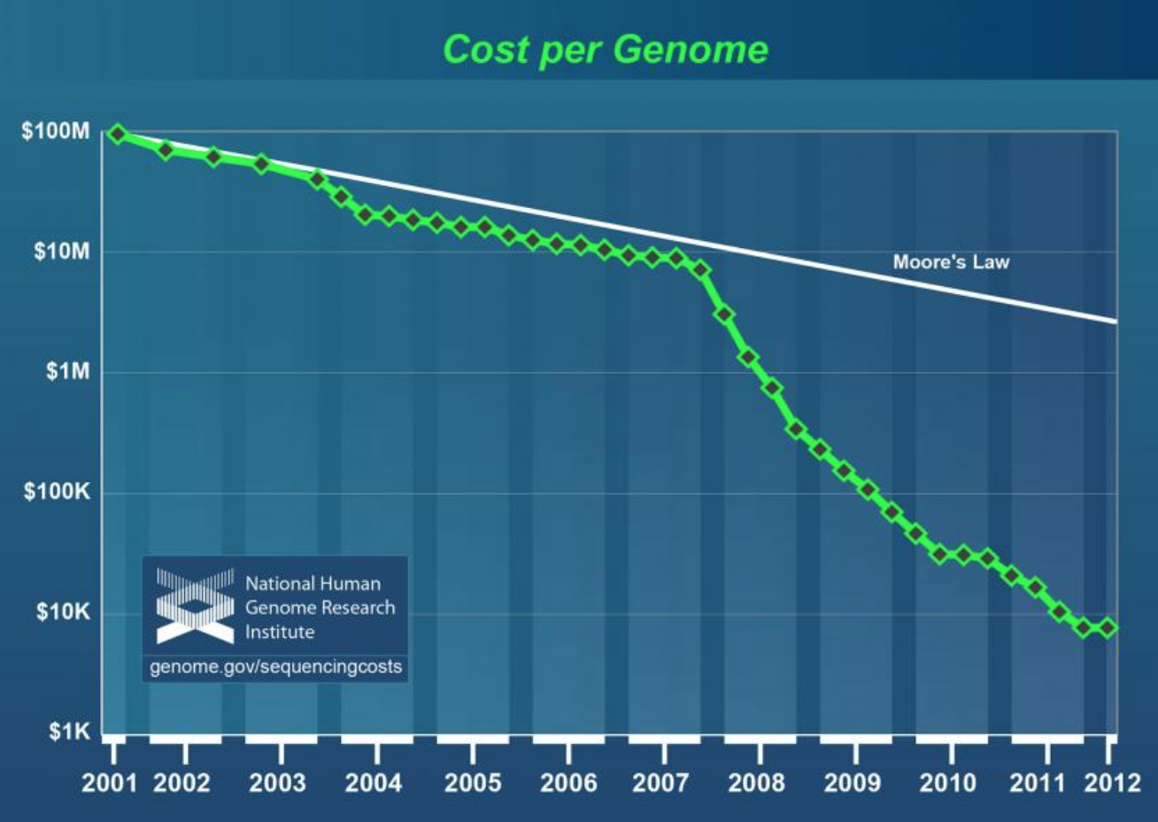
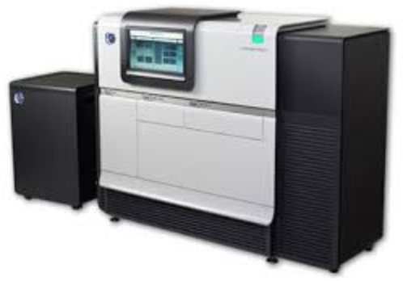
Genomic Data: Crushing Moore’s Law
Genome sequencing costs are dropping faster than compute is getting faster

Slide 5
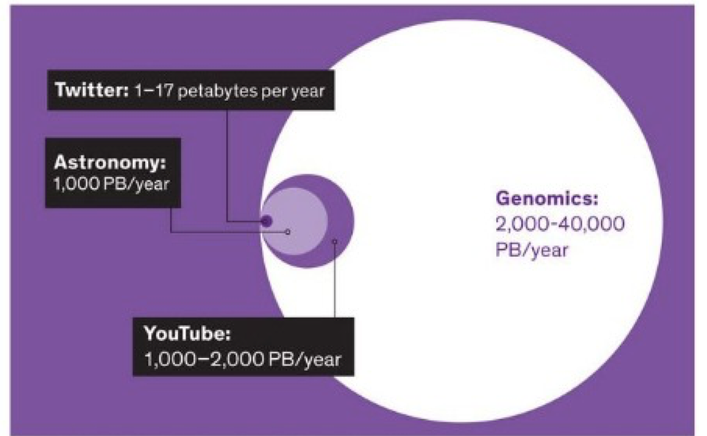
Genomic Data: THIS IS 1985!
Exponentially cheaper and cheaper!
Massive growth!
The genomics industry is the computer industry in 1985
Early times, immense promise

Slide 6
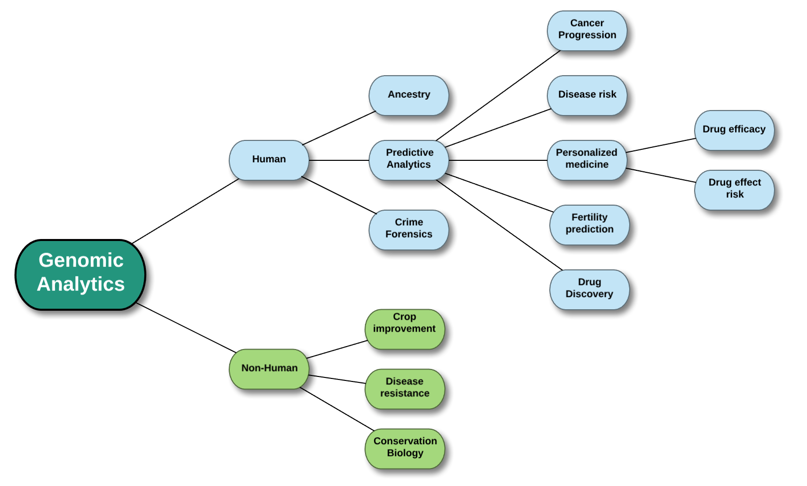
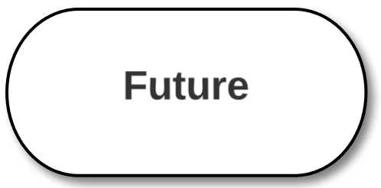
Genomic Analytics: Promise and Investment from All Sides

Slide 7
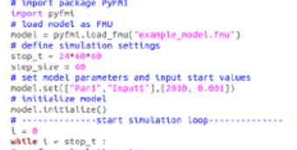
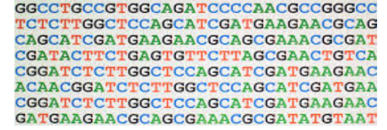
Hortonworks Platforms: Perfectly Positioned to Ride the Wave
Genomics data pipeline processing
Raw genomic data
Predictive & diagnostic value impacting lives
Unprecedented Data Volume retention
Smart Data Movement device to lake
Compute intensive
Advanced Analytics
Compute intensive
Full Control:
Governance | Security | Multitenancy

Slide 8
Hortonworks Genomics Platform
Background: Core genomics pipeline

Slide 9
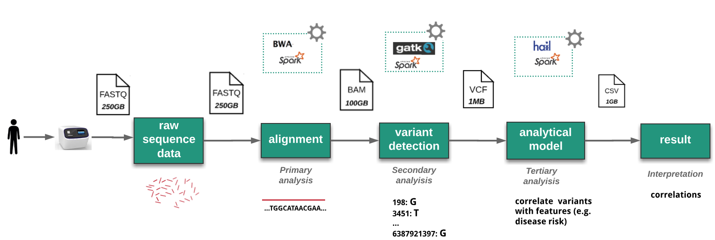
Core Genomics Pipeline
open source software
file format & size
pipeline step
pipeline result
Massive Data Volume
Compute Intensive
Governance | Security | Multitenancy | Custom models & Solutions

Slide 10
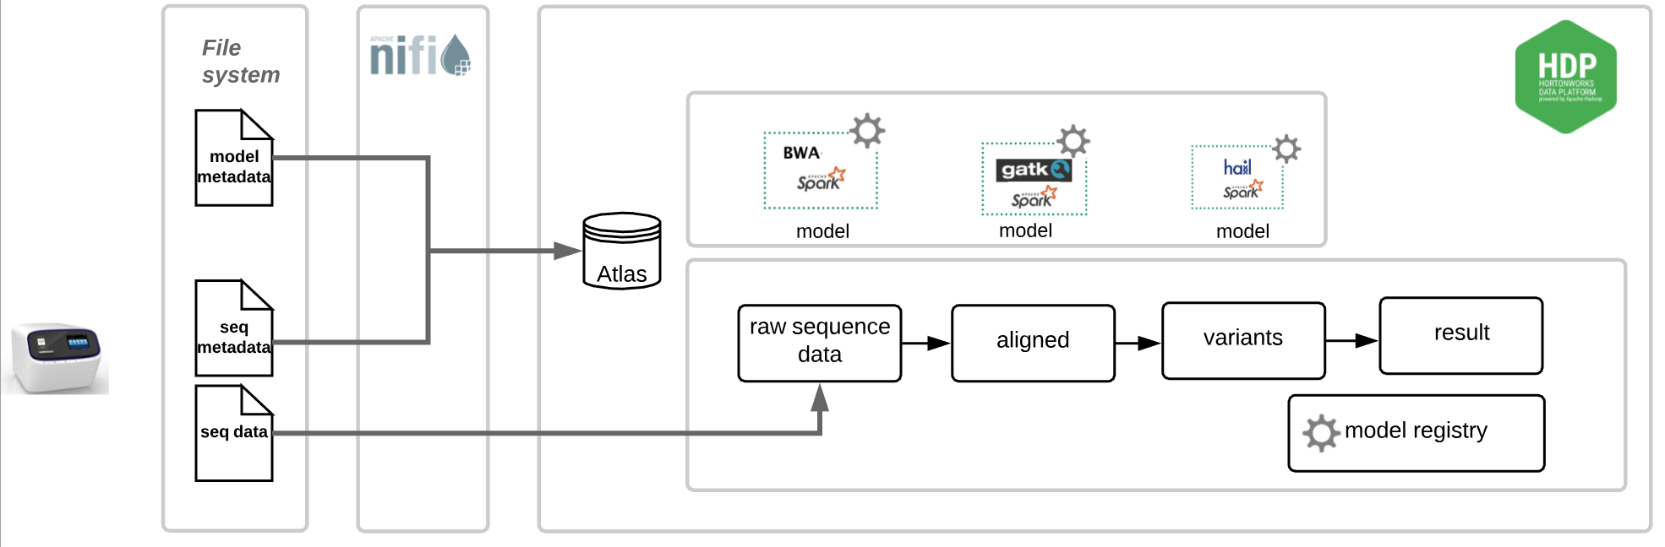
Hortonworks Core Platform & Differentiation
NiFi: smart routing of data
HDP: scalable storage and compute, cloud on-prem hybrid
Atlas: full lineage and understanding of what, where, when
Model registry: versioned models (referenced in Atlas lineage)
Docker: model independence (e.g Spark version dependencies)
Cloudbreak: easy deploy dockerized models
Full control of platform: solution for specific needs

Slide 11
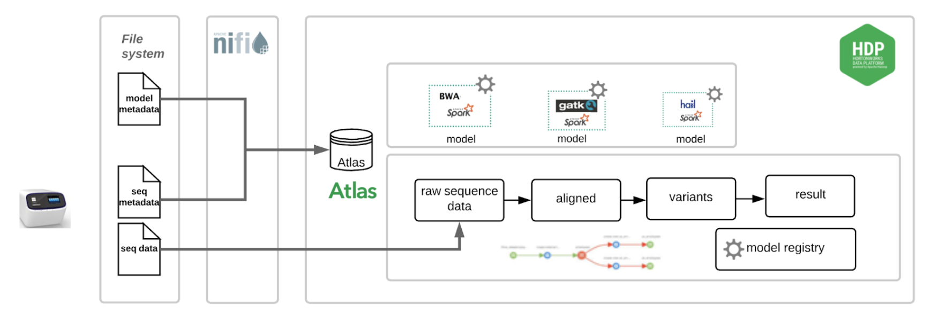
Demo 1: Differentiation with Governance
Customer challenges
How do I keep sense of all genomic data and processing in the lake?
How do I tie data to its source in the lab?
How do I track pipeline changes and model improvements
Demo
NiFi data to storage & metadata to Atlas
Atlas search
Atlas lineage: customized types for sequence device metadata, model metadata
Model registry: model audit and replay

Slide 12
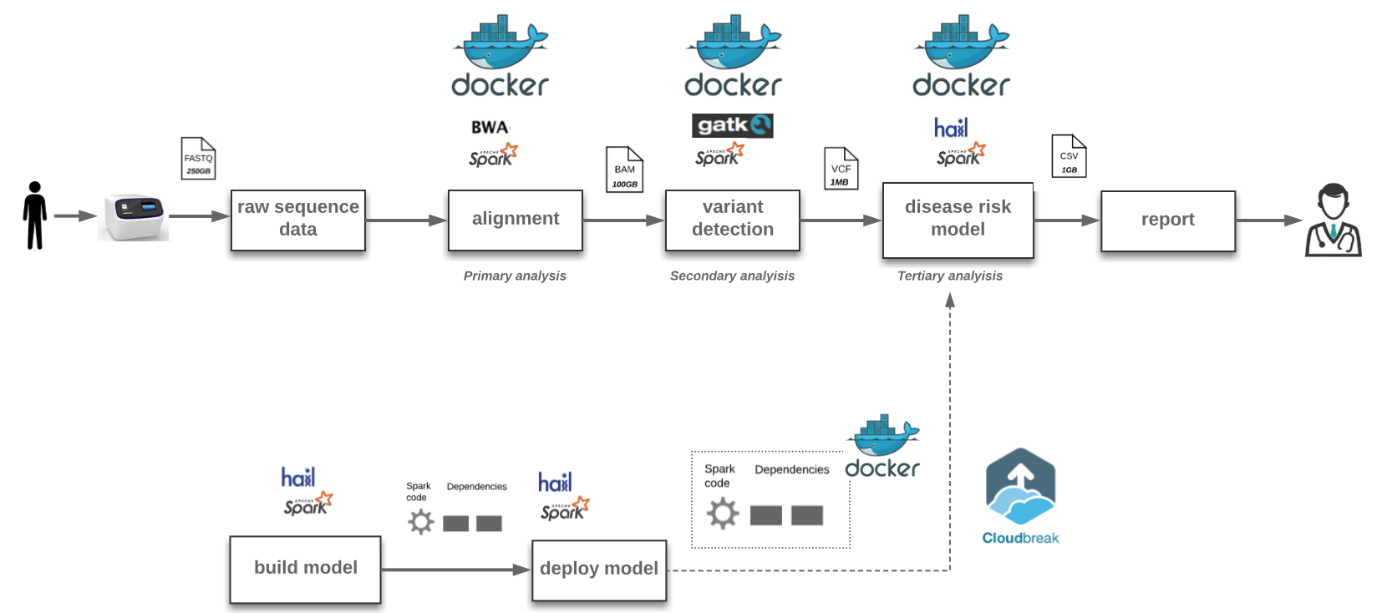
Demo 2: New layer of multitenancy with Docker
Customer challenges
Different steps in the pipeline have different Spark version dependencies
Different data scientists have different environments to deploy
Need to replay pipelines with past models concurrently with existing pipeline
Demo
Hail genomic analytics on docker: CLI & Jupyter

Slide 13
Hortonworks is Genomics

Slide 14
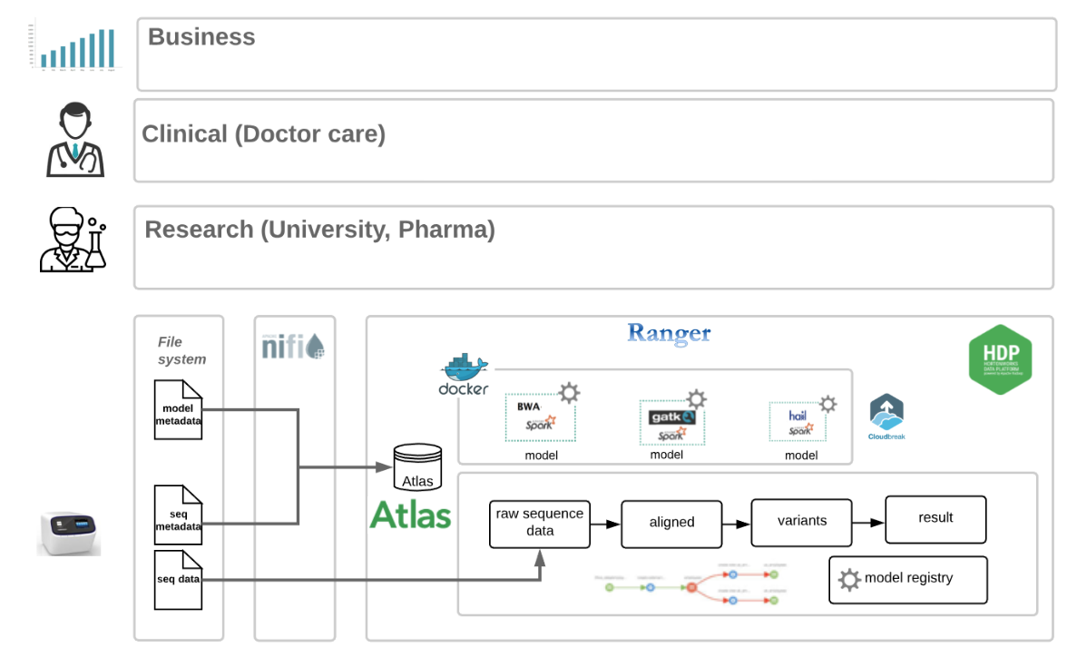
Hortonworks can differentiate and win in the genomics space and enter a new era
Hortonworks Genomic Core Platform clearly differentiates Hortonworks from other genomics platforms and solutions
Hortonworks Genomic Core Platform is one layer in a larger genomics, clinical, research, business platform

Slide 15
Thank you

